Slide 1

COMPUTER ORGANIZATION & ARCHITECTURE
Anatomy of a Computer System
Computer Types • Input Unit • Memory Unit • ALU • Output Unit • Control Unit
Semester III | B.Tech Computer Science Duration: 50 minutes | Lecture Session
Presidency University | School of Artificial Intelligence & Advanced Computing

Slide 2

ICE BREAKER
Two minutes, no wrong answers.
If your smartphone were a full-sized computer, what would each part be the size of?
Turn to your neighbour: name one part of your phone (screen, chip, battery, speaker) and guess what desktop-computer part it matches. We'll compare answers with today's topics.
02

Slide 3






TODAY'S ROADMAP
What We Will Cover
Types of Computers
Input Unit
Memory Unit
Analog, digital & hybrid; micro to super
How data enters the system
Primary, secondary & cache
Arithmetic & Logic Unit
Output Unit
Control Unit
Where computation happens
How results reach us
The orchestra conductor of the CPU
03

Slide 4

LEARNING OUTCOMES
By the End of This Lecture, You Will Be Able To...
Classify computers by type, size, and purpose, and justify the classification with real examples.
Describe the role of the five functional units of a computer system.
Trace how a single keystroke travels from Input → Memory → ALU → Control Unit → Output.
Map each functional unit to a real, everyday device you already use.
Answer viva/exam questions on the fetch-decode-execute cycle with confidence.
04

Slide 5

FOUNDATIONS
What Exactly Is a "Computer"?
A quick refresher before we classify and dissect one.
05

Slide 6
DEFINITION
A Computer, in One Sentence
An electronic device that accepts data (Input), stores and processes it under a set of instructions (Memory, ALU, Control Unit), and produces meaningful results (Output).
The Five Functional Units
INPUT UNIT
OUTPUT UNIT
MEMORY UNIT
REAL-TIME EXAMPLE A washing machine controller is a tiny "computer" — sensors (input) feed a chip (CU+ALU+memory) that drives the motor (output).
ALU
CONTROL UNIT
CPU = ALU + Control Unit + Registers
06

Slide 7

UNIT 1 – Topic 1
Types of Computers
Classifying machines by how they process data, and by size & power.
07

Slide 8



CLASSIFICATION — BY DATA HANDLING
Analog, Digital & Hybrid Computers
Analog Computer
Digital Computer
Hybrid Computer
Processes continuous physical signals (voltage, temperature, speed) rather than discrete numbers.
Processes data as discrete binary values (0s and 1s). Nearly all modern computers.
Combines analog input sensing with digital processing for precision.
Example: A fuel gauge or an old speedometer needle.
Example: Your laptop, smartphone, and this projector's PC.
Example: ICU patient monitors — sense analog vitals, display digital readouts.
08

Slide 9



CLASSIFICATION — BY SIZE & POWER
From Micro to Super: The Digital Computer Family
Microcomputer
Minicomputer
Mainframe
Supercomputer
Personal, single-user
Multi-user, mid-range
Large-scale, enterprise
Extreme-speed scientific
Increasing processing power & cost, decreasing user count per machine →
09

Slide 10
TYPE 1 OF 4
Microcomputers
The smallest and most common category — built around a single microprocessor chip, designed for one user at a time.
Compact, affordable, general-purpose
Includes desktops, laptops, tablets & smartphones
Sub-types: Desktop, Laptop/Notebook, Tablet, Smartphone, Wearable
REAL-TIME EXAMPLE The laptop or phone in your bag right now is a microcomputer.
10

Slide 11
TYPE 2 OF 4
Minicomputers
Mid-range systems more powerful than microcomputers, supporting multiple users simultaneously through terminals.
Multi-user, multi-tasking capability
Used in small-to-medium businesses & labs
Bridge between micro and mainframe scale
REAL-TIME EXAMPLE A university department server handling attendance for 50 lab terminals at once.
11

Slide 12
TYPE 3 OF 4
Mainframe Computers
Large, powerful systems that process massive volumes of data for hundreds of users, prized for reliability and uptime.
High throughput, strong data security
Run mission-critical business applications
Handle thousands of transactions per second
REAL-TIME EXAMPLE Banks use IBM Z mainframes to process millions of ATM & UPI transactions daily.
12

Slide 13
TYPE 4 OF 4
Supercomputers
The fastest, most powerful computers on Earth — thousands of processors working in parallel on massive scientific problems.
Measured in FLOPS (floating point ops/sec)
Used for simulation, modelling & forecasting
Extremely high cost, power & cooling needs
REAL-TIME EXAMPLE India's "PARAM Siddhi-AI" supercomputer forecasts monsoon weather patterns.
13

Slide 14
RECAP
Computer Types at a Glance
Type | Users | Typical Use | Real Example
Microcomputer | Single user | Personal computing | MacBook, iPhone
Minicomputer | Multiple users | Department-level systems | HP ProLiant server
Mainframe | Hundreds/thousands | Enterprise transactions | IBM Z16 (banking)
Supercomputer | Specialised teams | Scientific simulation | PARAM Siddhi-AI
14

Slide 15
ICE BREAKER
Quick poll — raise your hand.
Which computer type do you personally interact with the most before 9 AM?
Think: phone alarm (micro), campus Wi-Fi login (mini/server), UPI payment for breakfast (mainframe at the bank), or none? Let's tally hands by show.
15

Slide 16
UNIT 1 – Topic 1
The Input Unit
How the outside world talks to a computer.
16

Slide 17
FUNCTION
What Does the Input Unit Do?
The Input Unit converts data and instructions from a human-readable / physical form into machine-readable binary form, and sends it to memory for processing.
01001101
Keystroke
Binary Code
Main Memory
1
Accept data from the user or environment
2
Convert it into binary (0s & 1s)
REAL-TIME EXAMPLE Typing "hi" on your phone converts each letter into ASCII/Unicode binary before it ever reaches the messaging app.
3
Transmit it to main memory for processing
17

Slide 18


INPUT DEVICES — MANUAL ENTRY
Devices You Operate By Hand
Keyboard
Mouse / Touchpad
Joystick / Gamepad
Types characters, numbers & commands
Points, clicks & drags on screen
Directional & button-based control
Example: Writing this code on a laptop keyboard.
Example: Selecting a file icon on your desktop.
Example: Controlling a character in a racing game.
18

Slide 19



INPUT DEVICES — SENSING & CAPTURE
Devices That Read the Physical World
Scanner / Barcode Reader
Microphone
Camera / Webcam
Captures printed images or codes
Captures sound and converts to signal
Captures still or moving images
Example: Billing counter scanning a product barcode.
Example: Saying "Hey Google" to a smart speaker.
Example: Face-unlock scanning your face at login.
19

Slide 20

CASE STUDY
Input Unit in Action: An ATM Transaction
Card Swipe / Chip Read
PIN Entry via Keypad
Security Camera Capture
Magnetic stripe or chip data is read as input
Numeric keypad sends the 4-digit PIN as input
Captures your image for fraud verification
All three inputs are converted to binary and sent to the bank's system before a single rupee moves.
20

Slide 21
UNIT 1 – Topic 1
The Memory Unit
Where data and instructions live while they wait their turn.
21

Slide 22
THE MEMORY HIERARCHY
Speed vs. Capacity Trade-off
Registers
Fastest, tiniest — inside the CPU
Cache Memory
Very fast buffer between CPU & RAM
Primary Memory (RAM)
Fast, volatile working memory
Secondary Memory (SSD/HDD)
Slower, permanent storage
↑ Faster & costlier per byte ↓ Slower & cheaper per byte
22

Slide 23
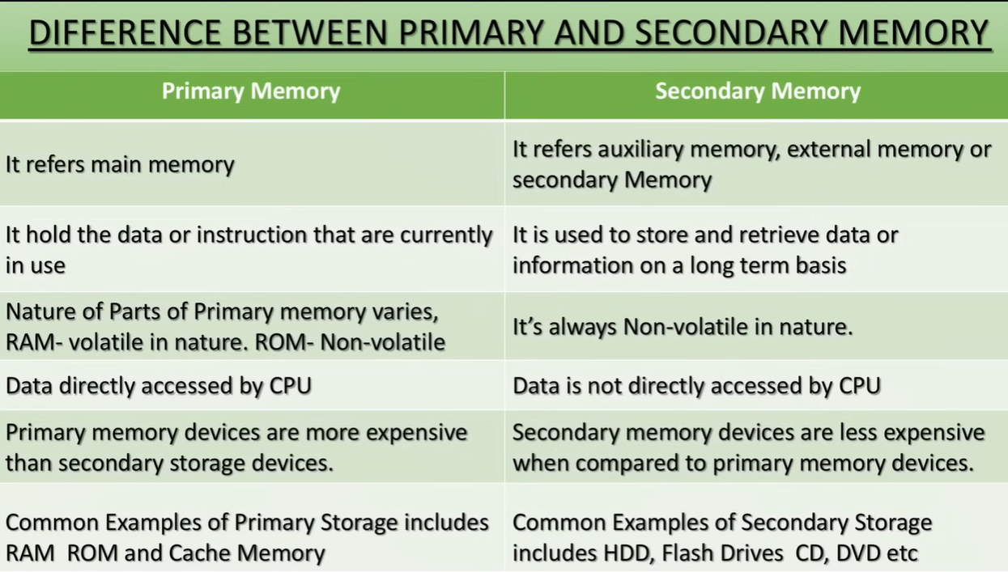

Slide 24

PRIMARY MEMORY
RAM vs. ROM
RAM (Random Access Memory)
ROM (Read-Only Memory)
Volatile — data lost when power is off
Read AND write; holds running programs
More RAM = smoother multitasking
Non-volatile — retains data without power
Mostly read-only; stores firmware
Holds startup instructions (bootloader)
REAL-TIME EXAMPLE Closing an unsaved Word file loses changes — they were only in RAM.
REAL-TIME EXAMPLE The BIOS/UEFI that boots your laptop before Windows loads.
23

Slide 25


SECONDARY MEMORY
Permanent, Non-Volatile Storage
Hard Disk Drive (HDD)
Solid State Drive (SSD)
Cloud Storage
Magnetic platters, high capacity, cheaper per GB
Flash memory, no moving parts, much faster
Remote servers accessed via internet
Example: A 1 TB external drive storing your photo library.
Example: Modern laptops booting Windows in under 15 seconds.
Example: Saving lecture notes to Google Drive from anywhere.
24

Slide 26
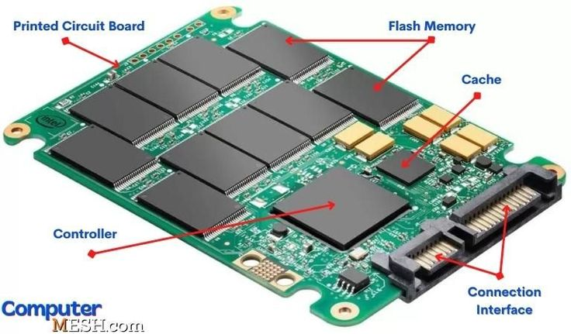

Slide 27
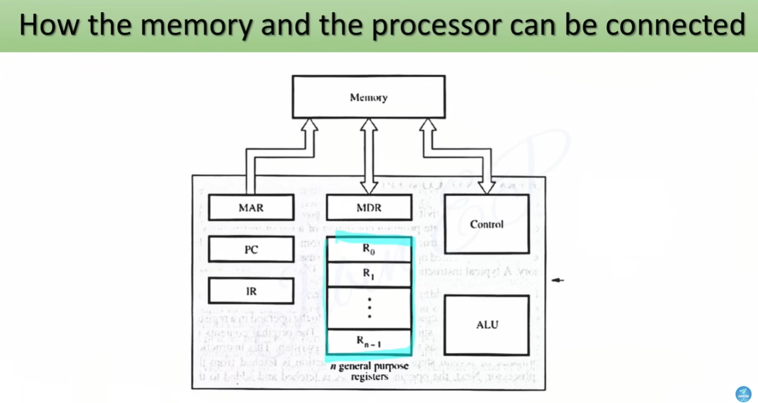

Slide 28
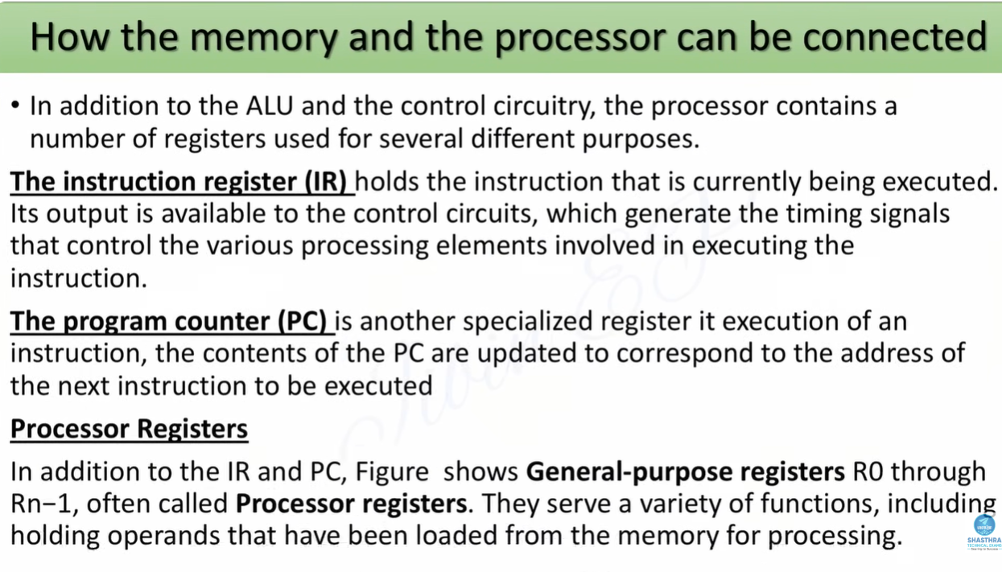

Slide 29
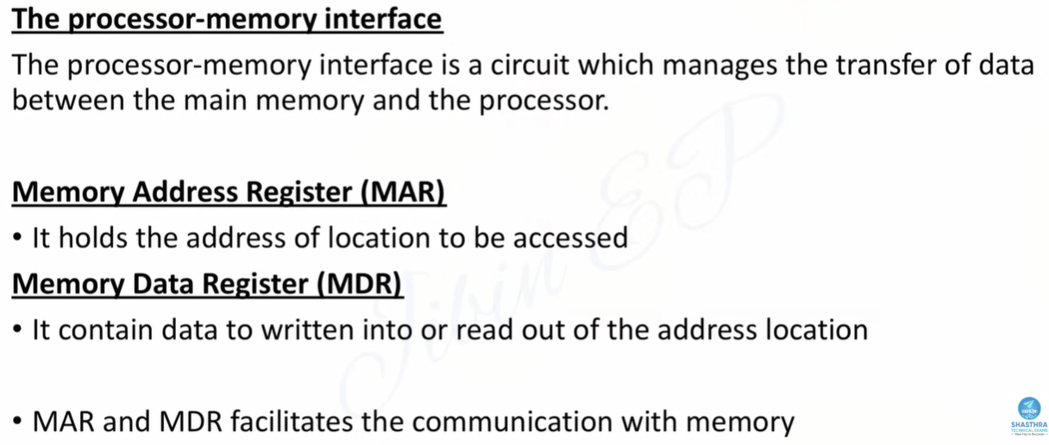

Slide 30
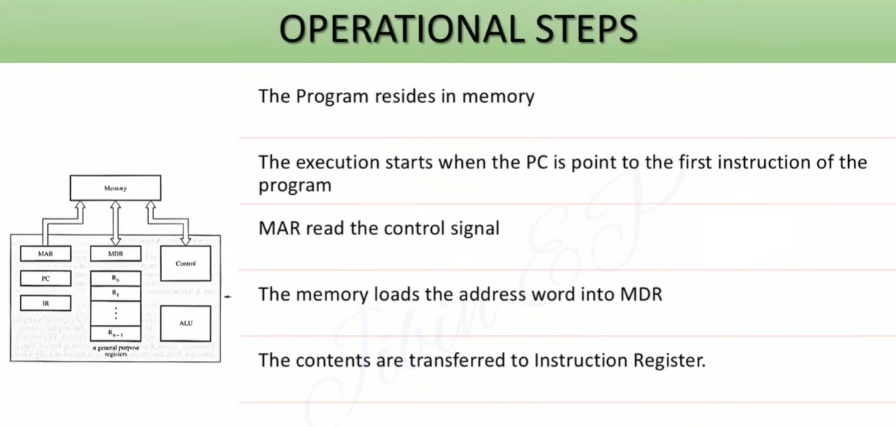

Slide 31
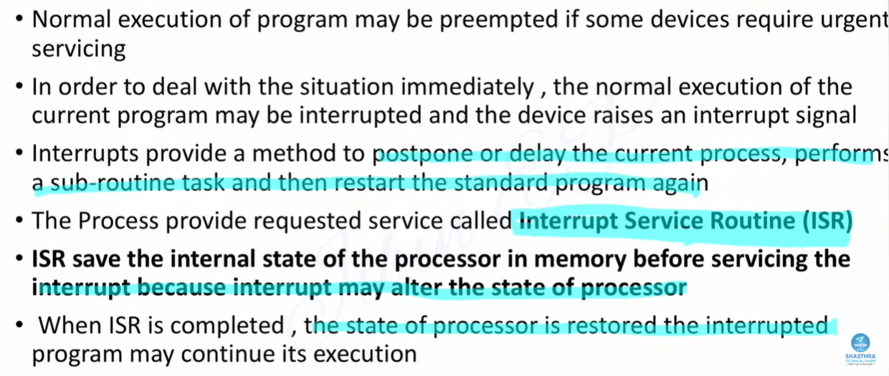

Slide 32
CASE STUDY
Cache Memory in Action: Why Apps Feel Instant
Cache memory stores frequently-used data close to the CPU so it doesn't have to fetch it from slower RAM every time.
Reopening a recently closed app loads almost instantly — its data was still in cache.
Your browser caches images of a website so a revisit loads faster.
YouTube pre-buffers (caches) the next few seconds of video while you watch.
CPU
Cache
Main RAM
25

Slide 33
UNIT 1 – Topic 1
Arithmetic & Logic Unit
The computational heart of the CPU.
26

Slide 34
FUNCTION
Two Jobs of the ALU
Arithmetic Operations
Logical Operations
Addition, subtraction
Multiplication, division
Increment / decrement operations
AND, OR, NOT, XOR comparisons
Greater-than / less-than decisions
Enables branching (if/else) in programs
REAL-TIME EXAMPLE Your calculator app computing 245 + 879 = 1124.
REAL-TIME EXAMPLE Checking "if age >= 18" on an online age-verification form.
27

Slide 35
CASE STUDY
ALU in Action: UPI Payment Split
When three friends split a ₹900 dinner bill equally using a UPI app:
1
Arithmetic: ALU divides ₹900 ÷ 3 = ₹300 per person
2
Logical: ALU checks IF (balance >= ₹300) before allowing payment
3
Arithmetic: ALU subtracts ₹300 from payer's balance
Every "smart" decision an app makes is really just ALU arithmetic + logic underneath.
28

Slide 36
UNIT 1 – Topic 1
The Output Unit
Turning processed binary back into something humans understand.
29

Slide 37


FUNCTION & DEVICES
Presenting the Processed Result
The Output Unit converts binary results from the CPU back into human-readable form — text, images, sound, or physical motion.
Monitor / Display
Printer
Speaker
Visual text, images & video output
Permanent hard-copy on paper
Audio output
Example: This slide projected on the classroom screen.
Example: Printing your semester hall ticket.
Example: A voice assistant reading out the weather.
30

Slide 38
CASE STUDY
Output in Action: Google Maps Navigation
Visual
Audio
Haptic
Turn-by-turn map & route line on screen
"Turn left in 200 metres" voice prompt
Vibration alert when you go off-route
One navigation instruction — three simultaneous output channels, all driven by the same processed data.
31

Slide 39
UNIT 1 – Topic 1
The Control Unit
The conductor that directs every other unit — without doing the computing itself.
32

Slide 40

FUNCTION
What the Control Unit Actually Does
The Control Unit (CU) does not process data itself. It directs and coordinates the activities of the input, memory, ALU, and output units by generating timing and control signals.
Fetches instructions from memory
Decodes what the instruction means
Directs the ALU / memory / I/O to execute it
Sequences everything in correct order & timing
REAL-TIME EXAMPLE Like a traffic police officer at a junction — doesn't drive any car, just directs the flow.
33

Slide 41
THE INSTRUCTION CYCLE
Fetch → Decode → Execute → Store
FETCH
CU retrieves the next instruction from memory
STORE
DECODE
Result is written back to memory / register
CU interprets what operation is required
This cycle repeats
billions of times per second.
EXECUTE
ALU / relevant unit performs the operation
34

Slide 42
CASE STUDY
Control Unit in Action: Opening a Camera App
1
FETCH: CU retrieves the "open camera" instruction triggered by your tap.
2
DECODE: CU recognises this means "launch camera application".
3
EXECUTE: CU signals ALU + memory + camera sensor (input) to activate.
4
STORE / OUTPUT: Live preview is sent to the display (output unit).
All of this happens in milliseconds — faster than your finger leaves the screen.
35

Slide 43
SYNTHESIS
Putting It All Together
MEMORY
UNIT
INPUT
UNIT
CONTROL
UNIT
OUTPUT
UNIT
ALU
CPU = Control Unit + ALU + Registers
REAL-TIME EXAMPLE Sending a WhatsApp voice note: Mic (input) → RAM (memory) → CU directs ALU to compress audio → speaker/network (output).
36

Slide 44
FULL CASE STUDY
Your Smartphone: All Five Units in One Device
Input
Touchscreen, mic, camera, fingerprint sensor
Memory
RAM for active apps + flash storage for files
ALU
Snapdragon/Exynos chip crunches every calculation
Control Unit
Coordinates app switching, notifications, calls
Output
AMOLED screen, speaker, haptic vibration
37

Slide 45
RECAP
Key Takeaways
Computers are classified by data type (analog/digital/hybrid) and by size & power (micro to super).
The Input Unit converts real-world data into binary for the machine to use.
The Memory Unit stores data/instructions — a hierarchy trading speed for capacity.
The ALU performs all arithmetic and logical computation.
The Output Unit converts binary results back into human-usable form.
The Control Unit directs and synchronises all other units via the fetch-decode-execute cycle.
38

Slide 46

RAPID QUIZ
Q1. Which topic we seen converts binary output into human-readable form?
Q2. Name one non-volatile memory type used to store firmware.
Q3. Which unit performs "if age >= 18" style comparisons?
Q4. What are the four stages of the instruction cycle?
39

Slide 47

Questions?
Thank you — see you in the next session on Basic Operational Concepts and Bus Structures.
40

